Slide 1

NATIONAL INSTITUTE OF TECHNOLOGY WARANGAL
PROJECT TITLE: CAR ACCIDENT DETECTOR AND INFORMER
Submitted To:
Mrs V. Rama
Asst. Professor,
Dept. of Electronics and Communication Engineering,
National Institute of Technology, Warangal.

Slide 2
ACKNOWLEDGEMENT
First of all, I would like to thank my parents for being with me and providing me with all the resources I required for building up this project. I express my special thanks to my professor Mrs V Rama, who always gave me guidance and helped me to know about the subject. It was her vision and motivation that led me to do this project. I had made this project from my heart and shown utmost sincerity to complete it while gaining knowledge about numerous new things that I don’t think would be possible in this
online semester. This project is not just limited to marks for me, it's my hard work and sheer interest in understanding new and possible technologies. I am very thankful to all those people who helped and guided me to make such a project.
Thank You
Siddharth Katiyar

Slide 3

May 12, 2021
CAR ACCIDENT DETECTOR AND INFORMER
Changes call for innovation, and
Innovation leads to progress.
Siddharth Deep Katiyar
192275

Slide 4

Abstract
A mechanism for the automation of accident detection and notifying the hospitals, police stations and relatives about the accident data.
The proposed device is for an accident notification system (A.N.S). This product could be used in vehicles to get the data of accident and further notifying police station and hospitals.

Slide 5

Goal
Reduce the no. of deaths in accident cases by informing hospitals at the earliest.
Track data of the car.
Solve various road accident cases and find the culprit by providing details of car location to the police station.

Slide 6
Problem Statements
2
1
No notification system in the car to notify about the accident.
2
Car tracking not available.
3
No Emergency system to notify about injured.
4
No system to notify damage percentage of the car.
5
No system to find lost and stolen cars.

Slide 7

SOLUTION
Instant Notification to Hospital in case of an accident.
Instant medical support to the injured person.
Instant information to the driver family.
Sound alarm information to locals present in the area.
Information regarding the car movement and history of car movement.
Instant notification to the police station and hence easy finding the reason of the accident.
1
2
3
4
5
6

Slide 8
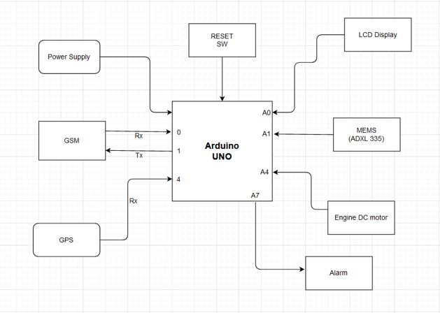
BASIC DIAGRAM OF THE MODEL

Slide 9
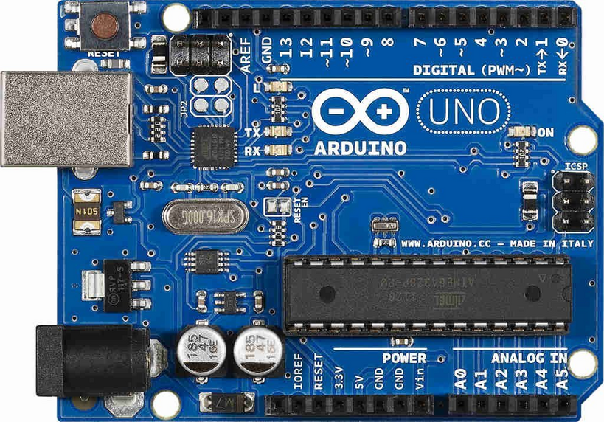
Components Used
1
Power supply with the processor
ARDUINO UNO
2

Slide 10
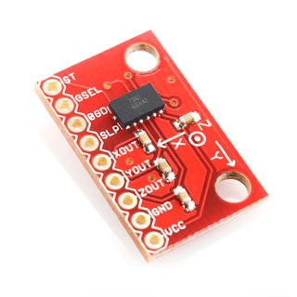
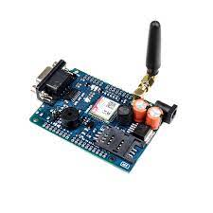
Components Used
3
Accelerometer dice
GSM with Processor as input and output.
4

Slide 11
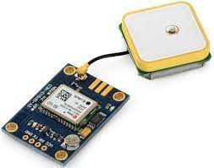
Components Used
5
GPS with the processor as input and output and device tracker.
6
Display unit for output from the processor.

Slide 12
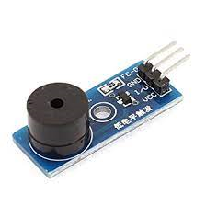
Components Used
7
Alarm Module

Slide 13
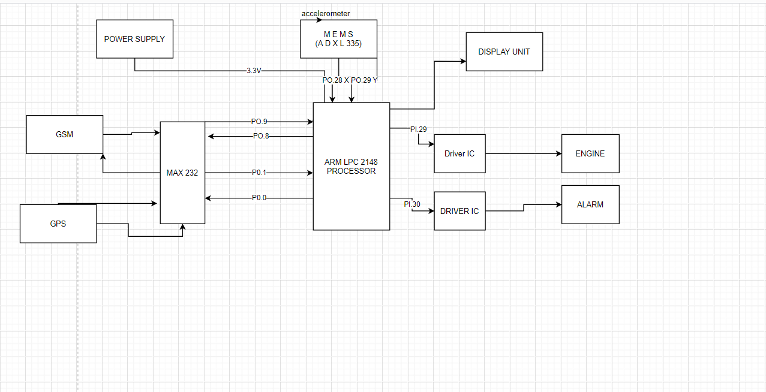
CIRCUIT DIAGRAM

Slide 14
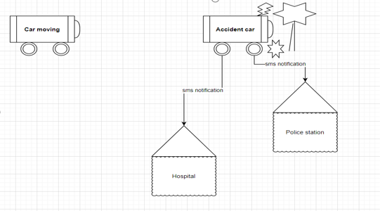
BASIC WORKING

Slide 15
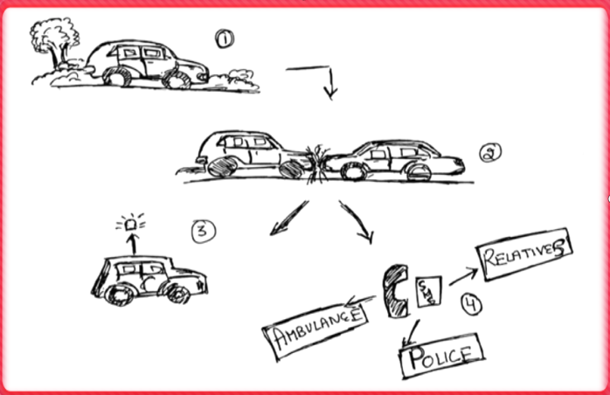


At the second point, the moving car has had an accident with another car.
The sudden change in acceleration will alert the accelerometer which will further trigger the alarm system to notify the nearby people who can provide first aid to the injured.
Then the GPS module will get activated and will notify the person’s family/relatives, police & ambulance or nearby hospital
Stimulus/Response Sequences
The accident will be detected by an accelerometer.
Engine stops.
Alarm starts.
Gsm model activates and sends a notification.
WORKING

Slide 16
System Interface
Attaching and integrating message system with Display.
Calling API of google map and converting longitude and longitude to location.
The device uses the latest messaging apps ex. messenger
Location sent can be used by any browser.

Slide 17
User Interface
The system can track geographical information automatically and sends an alert SMS regarding an accident.
Arduino system sends the alert message through the GSM MODULE to police, hospital, relatives. So they can immediately trace the location through the GPS MODEM, after receiving the information. Then after conforming to the location necessary action will be taken.
If the person meets with a small accident or if there is no serious threat to anyone`s life, then the alert message will be terminated.
If there is any damage to the device then the second part attached with the airbag inflator starts working which when gets excess nitrogen pumps and on the sensor which further send the notification.

Slide 18
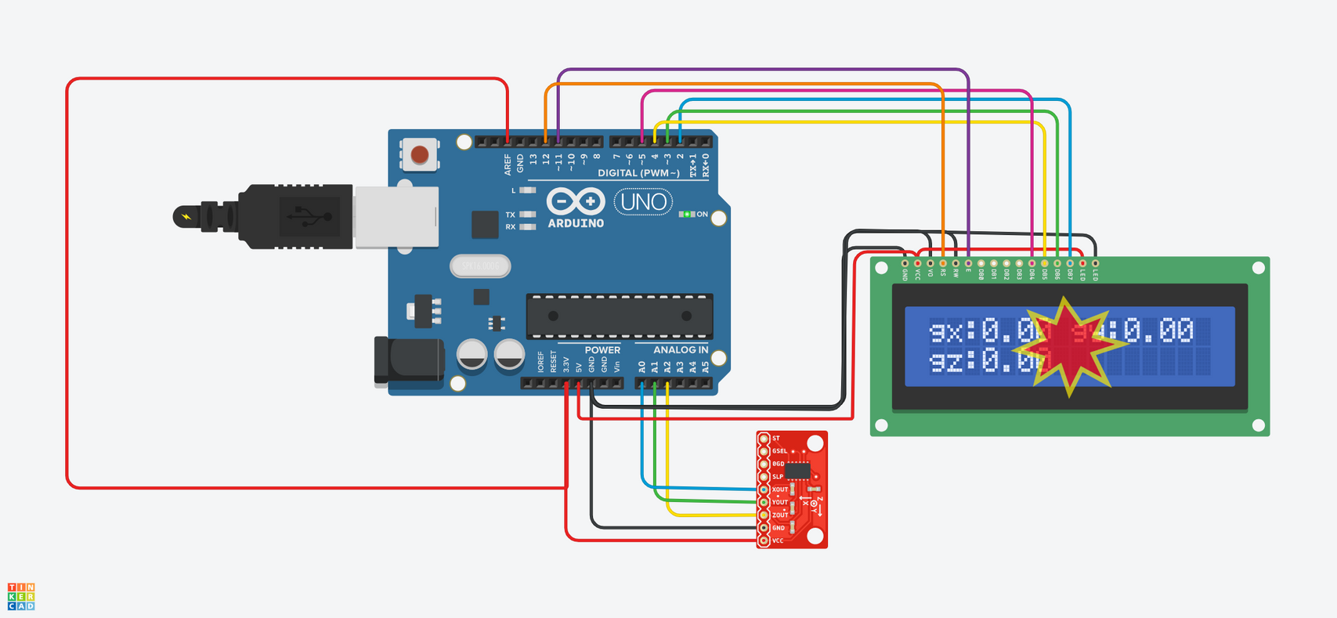
IF THERE'S A SUDDEN CHANGE, IT WILL ACTIVATE THE GPS MODULE
THIS WILL MEASURE THE CHANGE IN SPEED.
ACCELEROMETER

Slide 19
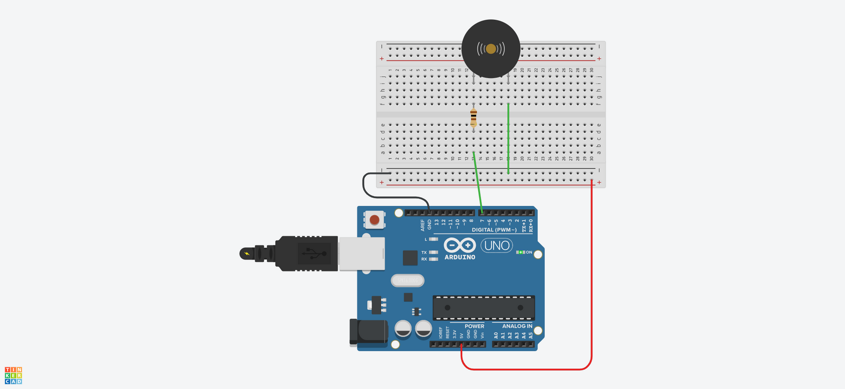
ALARM SYSTEM WILL BE ACTIVATED WHEN ACCIDENT HAS OCCURED
IT WILL ALARM THE LOCAL PEOPLE AROUND WHO CAN PROVIDE FIRST AID TO THE INJURED
BUZZER ALARM SYSTEM
START

Slide 20
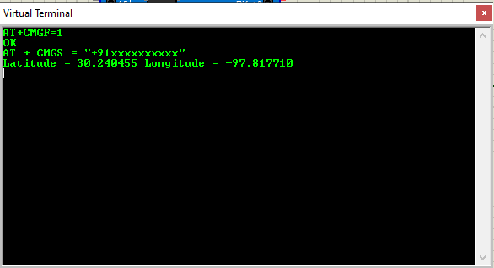
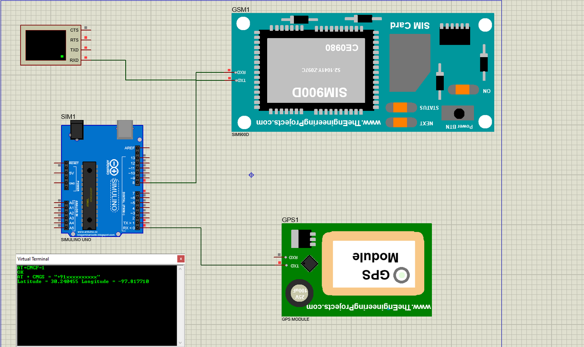
WHEN ATTACH TO ACCELEROMETER, IT GENERATE THE LOCATION OF THE ACCIDENT SPOT
IT WILL ALSO SEND THE LOCATION AS LINK OR SMS WHEN ATTACHED TO AN ANTENNAS
GPS MODULE

Slide 21
CODE FOR ACCELOROMETER
#include <LiquidCrystal.h>
LiquidCrystal lcd(12, 11, 5, 4, 3, 2);
int Xread;
int Xrest;
int Yread;
int Yrest;
int Zread;
int Zrest;
double Gx;
double Gy;
double Gz;
int xpin = 0;
int ypin = 1;
int zpin = 2;
int t1;

Slide 22
CODE FOR ACCELOROMETER
void setup()
{
Serial.begin(9600);
lcd.begin(16, 2);
digitalWrite(13,HIGH);
delay(1000);
Xrest=analogRead(xpin);
Serial.print(Xrest);
Yrest=analogRead(ypin);
Serial.print(Yrest);
Zrest=analogRead(zpin);
Serial.print(Zrest);
digitalWrite(13,LOW);
}
void loop()
{
Serial.print("Time ");
t1=millis();
Serial.println(t1*0.001);
Xread = analogRead(xpin)-Xrest;
Yread=analogRead(ypin)-Yrest;
Zread=analogRead(zpin)-Zrest;

Slide 23
CODE FOR ACCELOROMETER
Gx=Xread/67.584;
Gy=Yread/67.584;
Gz=Zread/67.584;
Serial.print("Acceleration X :");
Serial.print(Gx);
Serial.print("Acceleration Y :");
Serial.print(Gy);
Serial.print("Acceleration Z :");
Serial.print(Gz);
Serial.print("\n");
lcd.setCursor(0, 0);
lcd.print("gx:");
lcd.print(Gx);
lcd.setCursor(8, 0);
lcd.print("gy:");
lcd.print(Gy);
lcd.setCursor(0, 1);
lcd.print("gz:");
lcd.print(Gz);
delay(1000);
lcd.clear();
}

Slide 24
START
CODE FOR ALARM SYSTEM
void setup() {
pinMode(7, OUTPUT);
}
void loop(){
tone(7, 220, 100);
delay(200);
}

Slide 25
CODE FOR GPS MODULE
#include <TinyGPS.h>
#include <SoftwareSerial.h>
SoftwareSerial SIM900(7, 8);
TinyGPS gps; //Creates a new instance of the TinyGPS object
void setup()
{
Serial.begin(9600);
SIM900.begin(9600);
}
void loop()
{
bool newData = false;
unsigned long chars;
unsigned short sentences, failed;
// For one second we parse GPS data and report some key values
for (unsigned long start = millis(); millis() - start < 1000;)
{
while (Serial.available())
{
char c = Serial.read();
//Serial.print(c);
if (gps.encode(c))
newData = true;
}
}

Slide 26
CODE FOR GPS MODULE
if (newData) //If newData is true
{
float flat, flon;
unsigned long age;
gps.f_get_position(&flat, &flon, &age);
SIM900.print("AT+CMGF=1\r");
delay(400);
SIM900.println("AT + CMGS = \"+91xxxxxxxxxx\""); // recipient's mobile number with country code
delay(300);
SIM900.print("Latitude = ");
SIM900.print(flat == TinyGPS::GPS_INVALID_F_ANGLE ? 0.0 : flat, 6);
SIM900.print(" Longitude = ");
SIM900.print(flon == TinyGPS::GPS_INVALID_F_ANGLE ? 0.0 : flon, 6);
delay(200);
SIM900.println((char)26); // End AT command with a ^Z, ASCII code 26
delay(200);
SIM900.println();
}
Serial.println(failed);
// if (chars == 0)
// Serial.println("** No characters received from GPS: check wiring **");
}

Slide 27
Future Scope of the project
This project when integrated into a single unit can be used in automobiles as a safety device.
It will help save many lives with its early messaging system to alert hospitals or ambulances. Its alarm system will alert nearby people who could provide the injured with first aid.
It can also be used by police to detect the location of the vehicle and catch the thief.
when attached to a data storage device, this device can also be used to track the history of the automobile.
With the advancement in technology and growing demand for electrical automobiles, this device can make its way into the market easily as a safety and theft security device.

Slide 28
Accelerometer Circuit
https://www.tinkercad.com/things/7SPdOlcvGoo-accelerometer/editel?sharecode=AWAKqk--Babh8qxG-Ghb6Vm6u2fr0cd2DU-BpXzWtfM&sharecode=0PU2F7LBhMwZQ9wpf51yvOUmMKNRVELDbdA7qIqZHB4
1
Project Links
Alarm Circuit
https://www.tinkercad.com/things/92itu653XGR-buzzer-alarm-circuit/editel?sharecode=Y0ogA_wZcOL7kQ8OdPxAbWGa1kIQFLvJwZgHAw3U_NI&sharecode=KUuf9aAszDuNZmrkdrxA813SpzpWiAz8zrqXqmDCNRA
2
3
GSM Module
https://github.com/siddharth177/GSM-Module

Slide 29




References
Articles
https://www.thehindubusinessline.com/news/world/tesla-on-autopilot-drives-into-michigan-troopers-patrol-car/article34096921.ece
https://www.cnbc.com/2019/03/29/tesla-model-3-keeps-data-like-crash-videos-location-phone-contacts.html
https://www.eetimes.com/how-does-a-gps-tracking-system-work/#
Wikipedia
https://en.wikipedia.org/wiki/Vehicle_tracking_system
https://en.wikipedia.org/wiki/Automotive_navigation_system
How to electronics
https://how2electronics.com/gps-gsm-based-vehicle-tracking-system-using-arduino/

Slide 30
May 12, 2021
Thank you
Have a great day ahead.
Submitted by
Siddharth Deep Katiyar
Roll. No. :- 192275
Sec :- EEE B

